Slide 1
The Anatomy of an Argument
Resolving Conflicts Biblically
By
Phil klinefelter

Slide 2
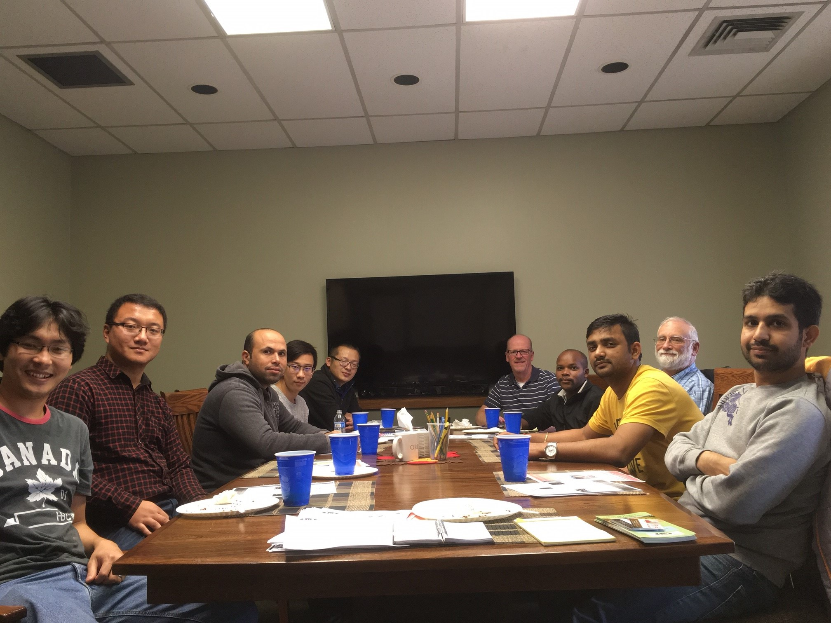
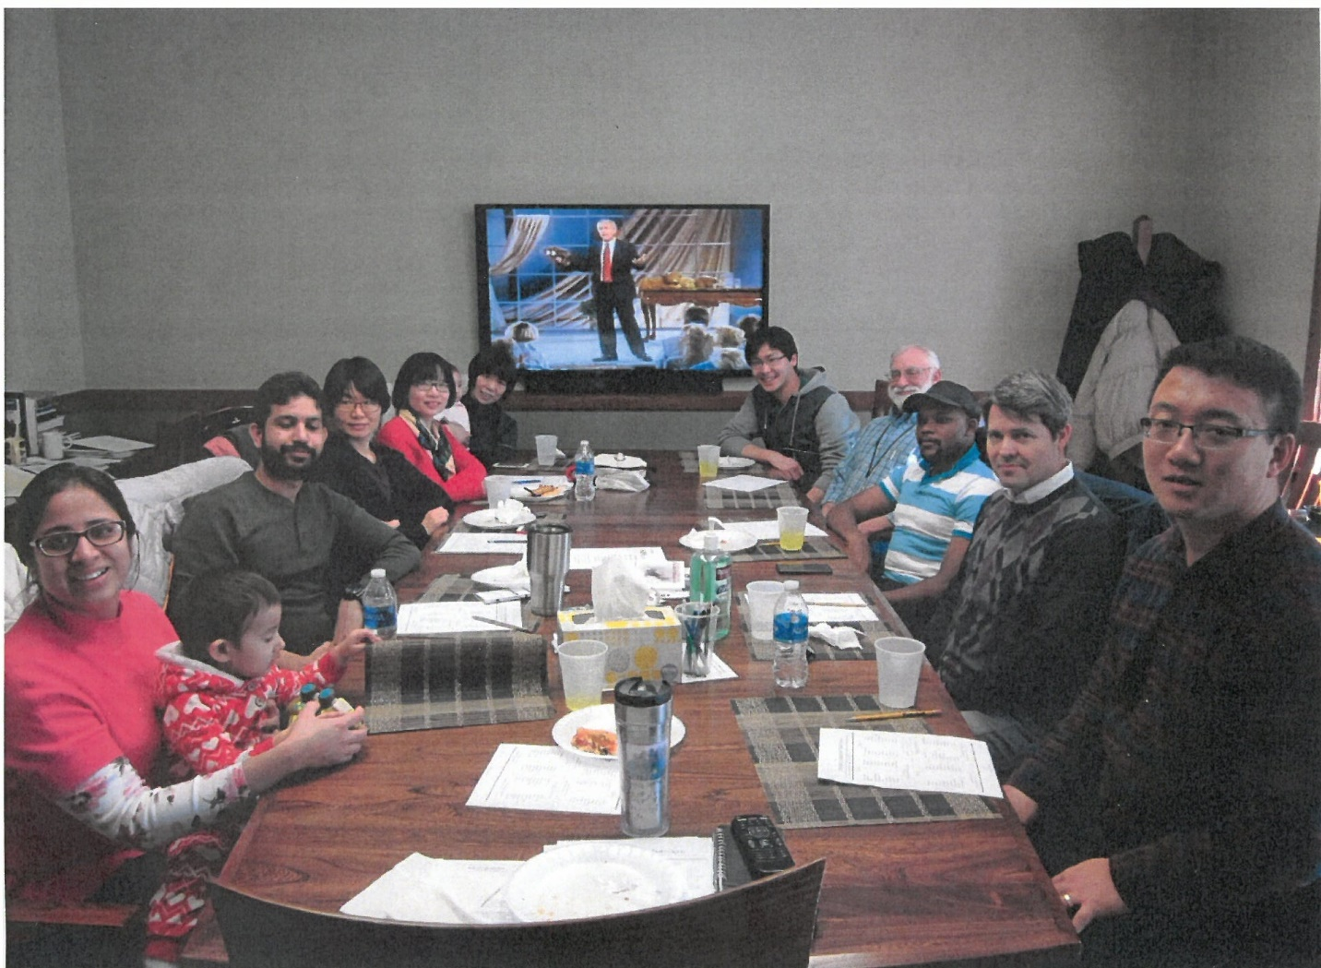
SECTION 1: Disagreements know no geographical boundaries

Slide 5
Go to higher ground
Get real about yourself
Accept responsibility
Gently restore
Go and be reconciled
Overcome evil with good
A NEW WAY OF THINKING.

Slide 6
romans 12:21
Do not be overcome by evil, but overcome evil with good

Slide 8
In Jesus Christ I have found the source of the power I need to lay down my “rights” and love beyond hope or reason to the amazement of a watching world.
Description here

